Slide 1
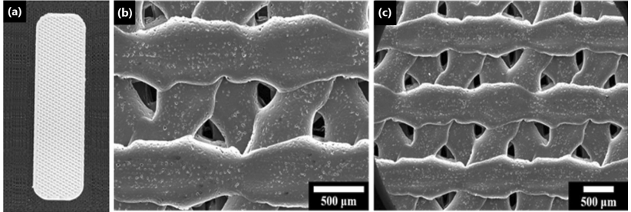
Morfoloji analizi
Park et al. Clinical Application of Three-Dimensionally Printed Biomaterial
Polycaprolactone (PCL) in Augmentation Rhinoplasty, Aesthetic Plastic Surgery

Slide 2
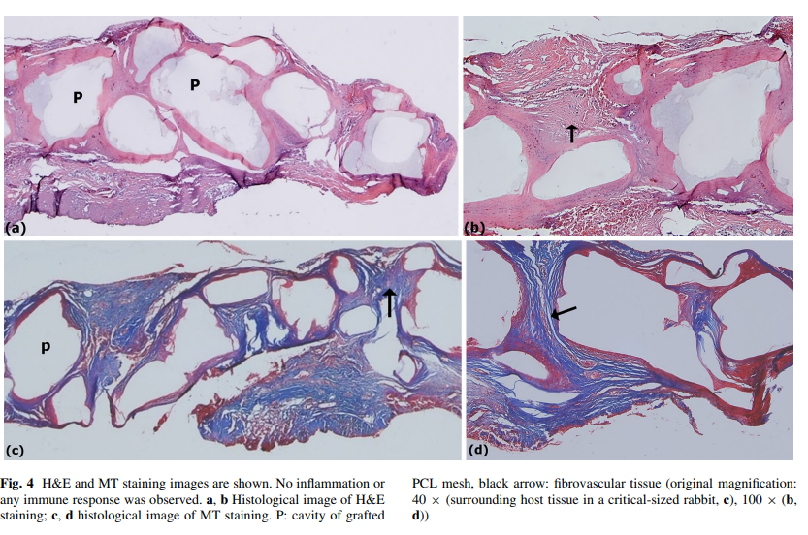
Hücre canlılığı ve damarlaşmanın değerlendirilmesi
Park et al. Clinical Application of Three-Dimensionally Printed Biomaterial
Polycaprolactone (PCL) in Augmentation Rhinoplasty, Aesthetic Plastic Surgery

Slide 3
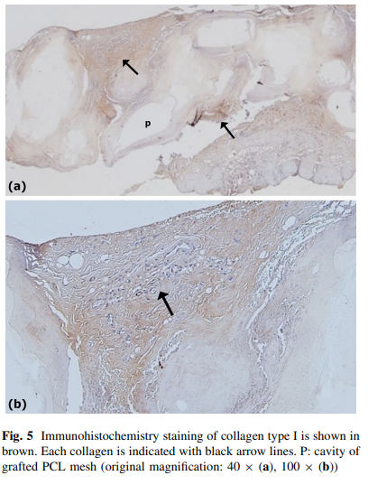
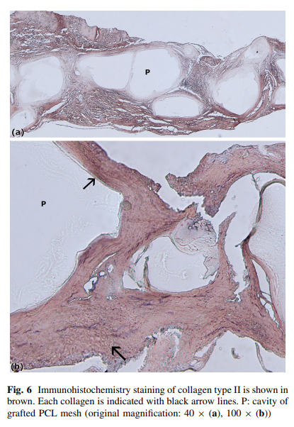
Clinical Application of Three-Dimensionally Printed Biomaterial
Polycaprolactone (PCL) in Augmentation Rhinoplasty
PCL in Kollojen uyarıcı etkisi
Park et al. Clinical Application of Three-Dimensionally Printed Biomaterial
Polycaprolactone (PCL) in Augmentation Rhinoplasty, Aesthetic Plastic Surgery

Slide 4
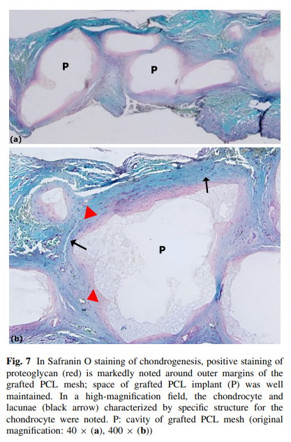
Kıkırdak doku oluşumu
Park et al. Clinical Application of Three-Dimensionally Printed Biomaterial
Polycaprolactone (PCL) in Augmentation Rhinoplasty, Aesthetic Plastic Surgery

Slide 5
Mineralization PCL/TCP
Yeo et al. Surface Modification Of PCL-TCP Scaffolds In Rabbit Calvaria Defects: Evaluation Of Scaffold Degradation Profile, Biomechanical Properties And Bone Healing Patterns, Journal Of Biomedical Materials Research

Slide 6
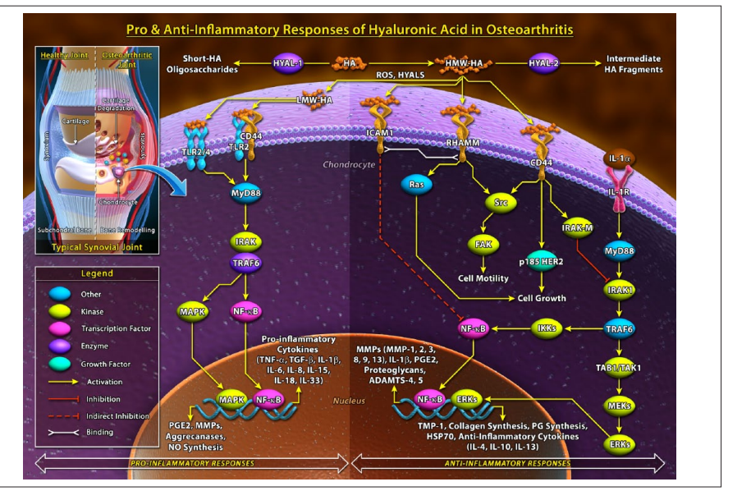
Anti-inflammatory effect of HA
Altman et al. Anti-Inflammatory Effects of Intra-Articular Hyaluronic Acid: A Systematic Review, Sage Journal

Slide 7
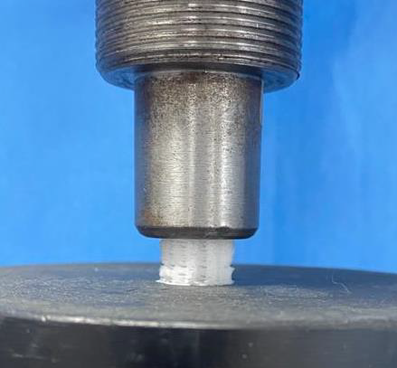
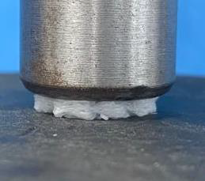
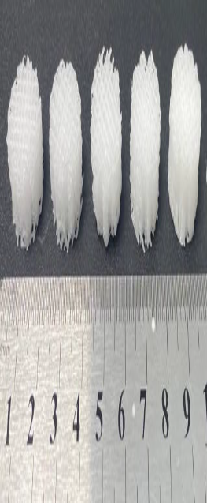
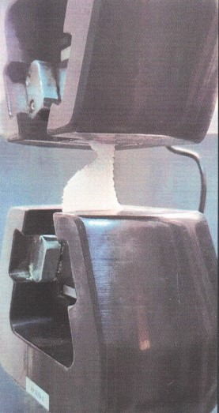
Mechanical evaluation

